Slide 1
The perfect solution for detecting sarcasm in tweets #not
Christine Liebrecht, Florian Kunneman, Antal van den Bosch

Slide 2
Introduction
Unlike a simple negation, a sarcastic message typically conveys a negative opinion using only positive words – or even intensified positive words.
The detection of sarcasm is therefore important, if not crucial, for the development and refinement of sentiment analysis systems, but is at the same time a serious conceptual and technical challenge.
In this paper we introduce a sarcasm detection system for tweets, messages on the microblogging service offered by Twitter.1 In doing this we are helped by the fact that sarcasm appears to be a well-understood concept by Twitter users, as seen by the relatively accurate use of an explicit marker of sarcasm, the hashtag ‘#sarcasm’.

Slide 3
Intensifier
There are sarcastic utterances which would still be qualified as sarcastic when all markers were removed from it (Attardo et al., 2003), for example the use of a hyperbole (Kreuz and Roberts, 1995).
It may be that a sarcastic utterance with a hyperbole(‘fantastic weather’ when it rains) is identified as sarcastic with more ease than a sarcastic utterance without a hyperbole (‘the weather is good’ when it rains).
Such hyperbolic words which strengthen the evaluative utterance are called intensifiers.
According to Van Mulken and Schellens (2012), an intensifier is a linguistic element that can be removed or replaced while respecting the linguistic correctness of the sentence and context, but resulting in a weaker evaluation.
A commonly used way to intensify utterances is by using word classes such as adverbs (‘very’) or adjectives (‘fantastic’ instead of ‘good’).

Slide 4
Data
For the collection of tweets for this study we make use of a database provided by the Netherlands e-Science Centre, consisting of a substantial portion of all Dutch tweets posted from December 2010 onwards.
From this database, we collected all tweets that contained the marker ‘#sarcasme’, the Dutch word for sarcasm with the hashtag prefix. This resulted in a set of 77,948 tweets.
We also collected all tweets posted on a single day, namely February 1, 2013. This set of tweets contains approximately 3,3 million tweets, of which 135 carry the hashtag #sarcasme.

Slide 5
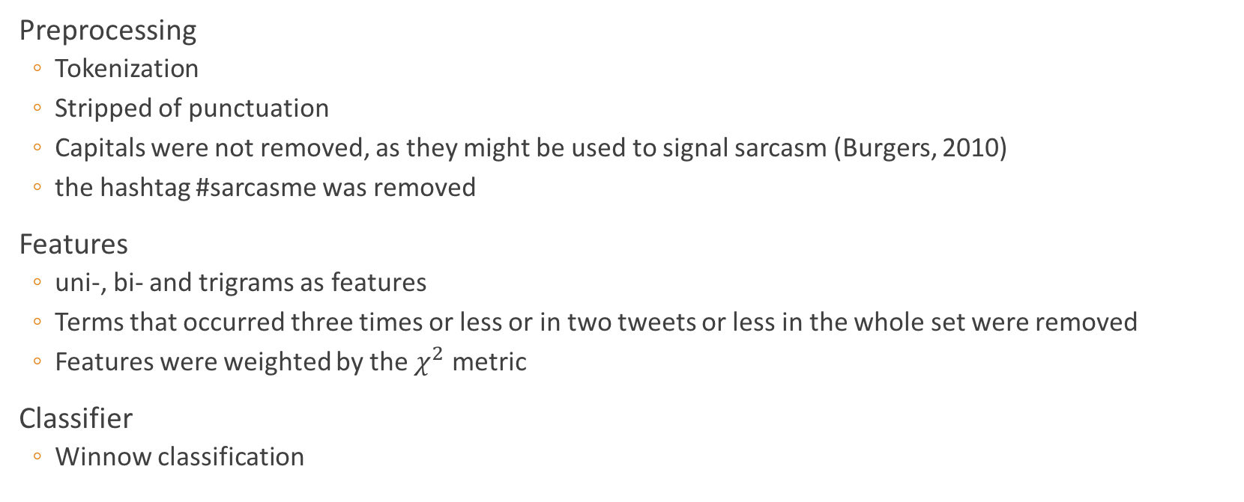
Classification
Preprocessing
Tokenization
Stripped of punctuation
Capitals were not removed, as they might be used to signal sarcasm (Burgers, 2010)
the hashtag #sarcasme was removed
Features
uni-, bi- and trigrams as features
Terms that occurred three times or less or in two tweets or less in the whole set were removed
Features were weighted by the $χ^{2}$ metric
Classifier
Winnow classification

Slide 6
Experiment
To train the classifier on distinctive features of sarcasm in tweets
Background corpus
Combined the set of 78 thousand sarcasm tweets with a random sample of other tweets posted on February 1, 2013
Excluded any of the 135 explicitly marked sarcasm tweets posted on February 1, 2013
As the size of a background corpus can influence the performance of the classifier, we performed a comparative experiment with two distributions between sarcasm-labeled tweets and background tweets:
in the first variant, the division between the two is 50%–50%
in the second, 25% of the tweets are sarcasm-labeled, and 75% are background.

Slide 7
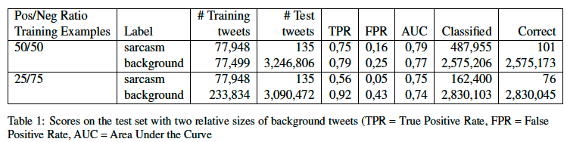
Evaluation

Slide 8
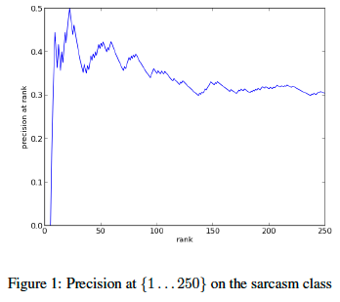
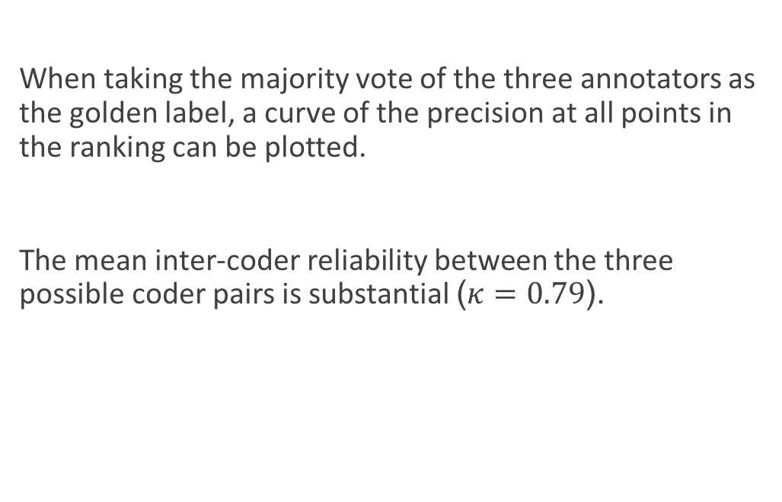
Evaluation
When taking the majority vote of the three annotators as the golden label, a curve of the precision at all points in the ranking can be plotted.
The mean inter-coder reliability between the three possible coder pairs is substantial ($κ=0.79$).

Slide 9
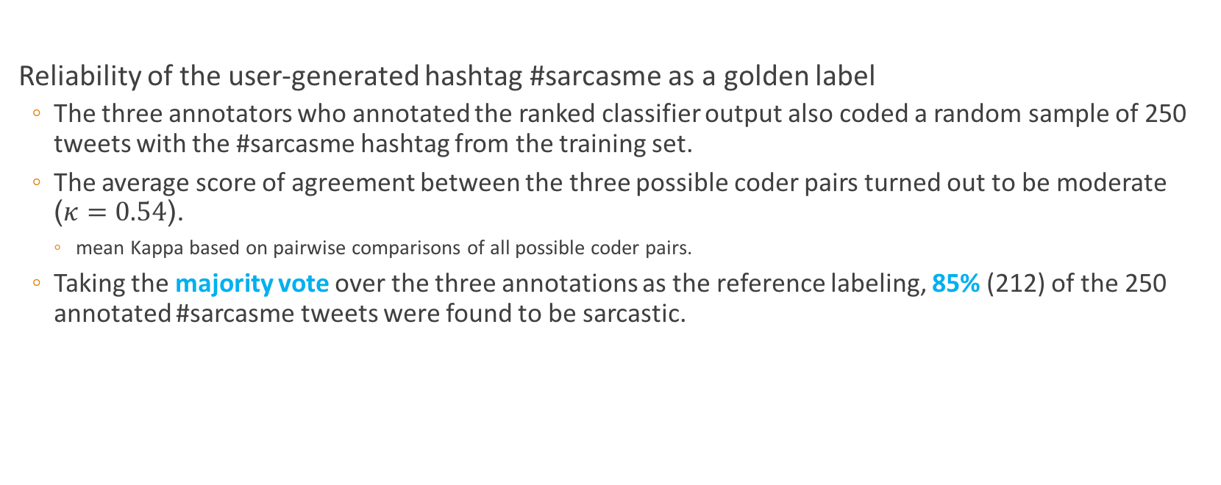
Analysis
Reliability of the user-generated hashtag #sarcasme as a golden label
The three annotators who annotated the ranked classifier output also coded a random sample of 250 tweets with the #sarcasme hashtag from the training set.
The average score of agreement between the three possible coder pairs turned out to be moderate ($κ=0.54$).
mean Kappa based on pairwise comparisons of all possible coder pairs.
Taking the majority vote over the three annotations as the reference labeling, 85% (212) of the 250 annotated #sarcasme tweets were found to be sarcastic.

Slide 10
Analysis
We set out to analyze the feature weights assigned by the Balanced Winnow classifier ranked by the strength of their connection to the sarcasm label, taking into account the 500 words and n-grams with the highest positive weight towards the sarcasm class.
These words and n-grams provide insight into the topics Twitter users are talking about: their targets.
School
such as homework, books, exams, classes (French, chemistry, physics), teachers, the school picture, sports day, and (returning from) vacation
Weather
the temperature, rain, snow, and sunshine
Other
social media itself, holidays, public transport, soccer, television programs (The Voice of Holland), celebrities (Justin Bieber), the church, the dentist and vacuum cleaning
Many of these topics are indicative of the young age, on average, of Twitter users.

Slide 11
Analysis
The strongest linguistic markers of sarcastic utterances are markers that can be seen as
synonyms for #sarcasme
such as sarcasme (without #), #ironie and ironie (irony), #cynisme and cynisme (cynicism)
words that are strongly related to those concepts by marking the opposite of the expressed utterance
#humor, #LOL, #joke (grapje), and #NOT.
Second, the utterances contain much positive exclamations that make the utterance hyperbolic and thereby sarcastic.
Examples of those markers in Dutch are (with and without # and/or capitals): jippie, yes, goh, joepie, jeej, jeuj, yay, woehoe, and wow.

Slide 12
Analysis
The list of strongest predictors show that some intensifiers are indeed strong predictors of sarcasm
such as geweldig (awesome), heerlijk (lovely), prachtig (wonderful), natuurlijk (of course), gelukkig (fortunately),zoooo (soooo), allerleukste (most fun), fantastisch (fantastic), and heeel (veeery).
Many unmarked positive words occur in the list of strongest predictors as well
such as fijn (nice), gezellig (cozy), leuk (fun), origineel (original), slim (smart), favoriet (favorite), nuttig (useful), and chill.
Considerably less negative words occur as strong predictors.
This supports our hypothesis that the utterances are mostly positive
This finding corresponds with the results of Burgers (2010), who show that 77% of the ironic utterances in Dutch communication are literally positive.

Slide 13
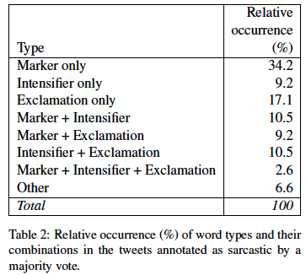
Analysis
Analyzing the 76 tweets that our classifier correctly identifies in the top-250 tweets the classifier rates as sarcastic
34.2%, are not hyperbolic at all
59.2% of the tweets does contain hyperbole inducing elements, such as an intensifier or an exclamation, or combinations of these elements
A full combination of explicit markers, intensifiers, and exclamations only rarely occurs(2.6%)
The three categories of predictive word types do cover 93.4% of the tweets.

